Slide 1
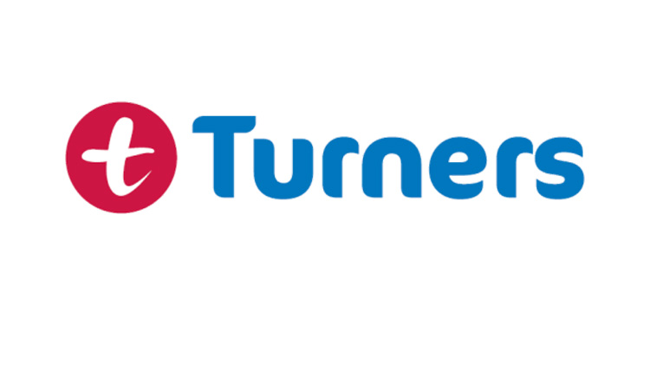
Turners Car Insurance Project: Mission 1
Advanced Full Stack Developer
Javan Cassidy

Slide 2

Introduction
Project Overview:
New Zealand automotive industry leader Turners Car Auctions is:
Redesigning its motor vehicle insurance systems
Enhancing the buyer experience through new technologies
Advanced Full Stack Developer
Javan Cassidy
Notes:
Project Overview: Turners Car Auctions, a leader in the New Zealand automotive industry, is redesigning its motor vehicle insurance systems to enhance the buyer experience through new technologies.

Slide 3

Introduction
Mission Statement:
As an Advanced Full-Stack Developer, I will:
Understand the project context
Identify key stakeholders
Apply professional skills
Use task management tools
Prototype an AI solution for car-type recognition
Present the work and submit the completed tasks
Advanced Full Stack Developer
Javan Cassidy
Notes:
Mission Statement: As an Advanced Full Stack Developer, my role is to understand the project context, identify key stakeholders, apply professional skills, use task management tools, prototype an AI solution for car type recognition, present the work, and submit the completed tasks.

Slide 4
Identify Stakeholders
Identified Stakeholders:
Project Sponsor (Turners Executive Team)
Project Manager
Insurance Division Head
IT Department
Finance Department
Finance Department
Marketing Department
Sales Team
Customer Support team
External Consultants/ Contractors
Regulator Bodies
Project Brief Summary:
New Zealand automotive industry leader Turners Car Auctions is redesigning its motor vehicle insurance systems to enhance the buyer experience through new technologies.
Javan Cassidy
Advanced Full Stack Developer
Notes:
Identified Stakeholders:
Project Sponsor (Turners Executive Team)
Role: Provide funding, strategic direction, and executive support for the project.
Interest: Ensuring the project aligns with Turner’s strategic goals and enhances market leadership.
Project Manager
Role: Oversees the project, coordinates activities and manages the project team.
Interest: Ensuring the project is completed on time, within scope, and budget.
Insurance Division Head
Role: Leads the insurance division, providing insights on current systems and future requirements.
Interest: Enhancing the insurance product offerings and improving operational efficiency.
IT Department
Role: Responsible for implementing the new technologies and maintaining the systems.
Interest: Ensuring the technological solutions are robust, scalable, and secure.
Finance Department
Role: Manages the financial aspects of the project, including budgeting and financial reporting.
Interest: Ensuring cost-effective use of resources and achieving a positive return on investment.
Marketing Department
Role: Promotes the new insurance products and communicates benefits to potential customers.
Interest: Creating compelling marketing campaigns to drive sales and customer engagement.
Customers
Role: End-users of the insurance products.
Interest: Receiving a seamless, user-friendly experience when purchasing insurance.
Sales Team
Role: Directly interacts with customers, selling insurance products.
Interest: Having clear and attractive products to sell and tools that facilitate the sales process.
Customer Support Team
Role: Provide assistance and support to customers with insurance-related inquiries.
Interest: Having efficient systems to resolve customer issues and improve satisfaction quickly.
External Consultants/Contractors
Role: Provide specialised expertise and support in AI implementation and system integration.
Interest: Successfully delivering their portion of the project and enhancing their reputation.
Regulatory Bodies
Role: Ensure compliance with industry regulations and standards.
Interest: Ensuring the new systems meet all legal and regulatory requirements.

Slide 5

Understand the Context of a Project
Introduction: When starting a project, it is crucial to have a solid understanding of certain key aspects to ensure effective contribution and alignment with the project goals.
Here are five of the most important things to know before starting:
Project Goals and Objectives
Roles and Responsibilities
Timeline and Deadlines
Available Resources
Potential Risks and Challenges
Javan Cassidy
Advanced Full Stack Developer
Notes:
1. Project Goals and Objectives
Description: Understanding the primary goals and objectives of the project is essential. This knowledge helps to align your efforts with the desired outcomes and ensures that all team members are working towards the same targets.
2. Roles and Responsibilities
Description: Knowing the roles and responsibilities of all team members, including your own, helps to clarify expectations and streamline collaboration. This prevents overlap, ensures accountability, and helps you understand who to approach for specific issues or tasks.
3. Timeline and Deadlines
Description: A clear understanding of the project timeline and key deadlines is vital for effective time management and prioritization. It helps in planning your work, identifying critical milestones, and ensuring timely delivery.
4. Available Resources
Description: Knowing what resources are available, such as budget, technology, personnel, and tools, helps in planning and executing your tasks effectively. It also helps to identify any constraints that may impact the project.
5. Potential Risks and Challenges
Description: Understanding the potential risks and challenges associated with the project allows for proactive planning and risk mitigation. This ensures that you are prepared to handle obstacles that may arise during the project.
Conclusion: By gaining clarity on these five critical aspects, you can work more effectively and contribute significantly to the success of the project.

Slide 6
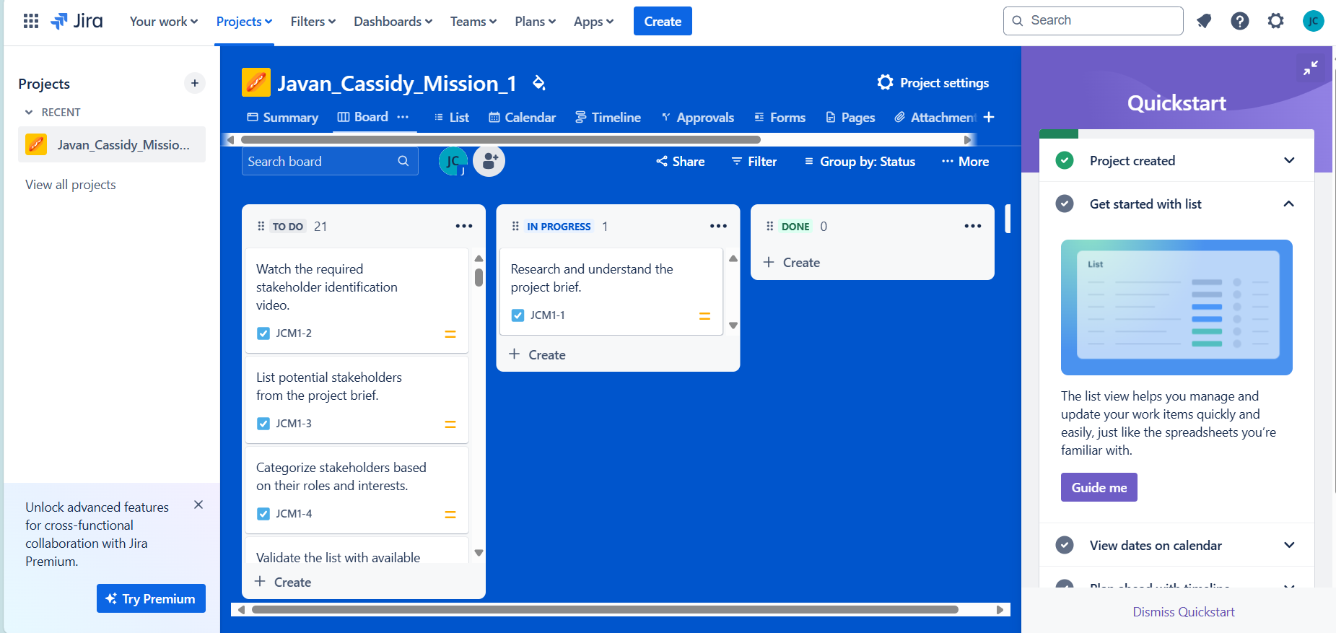
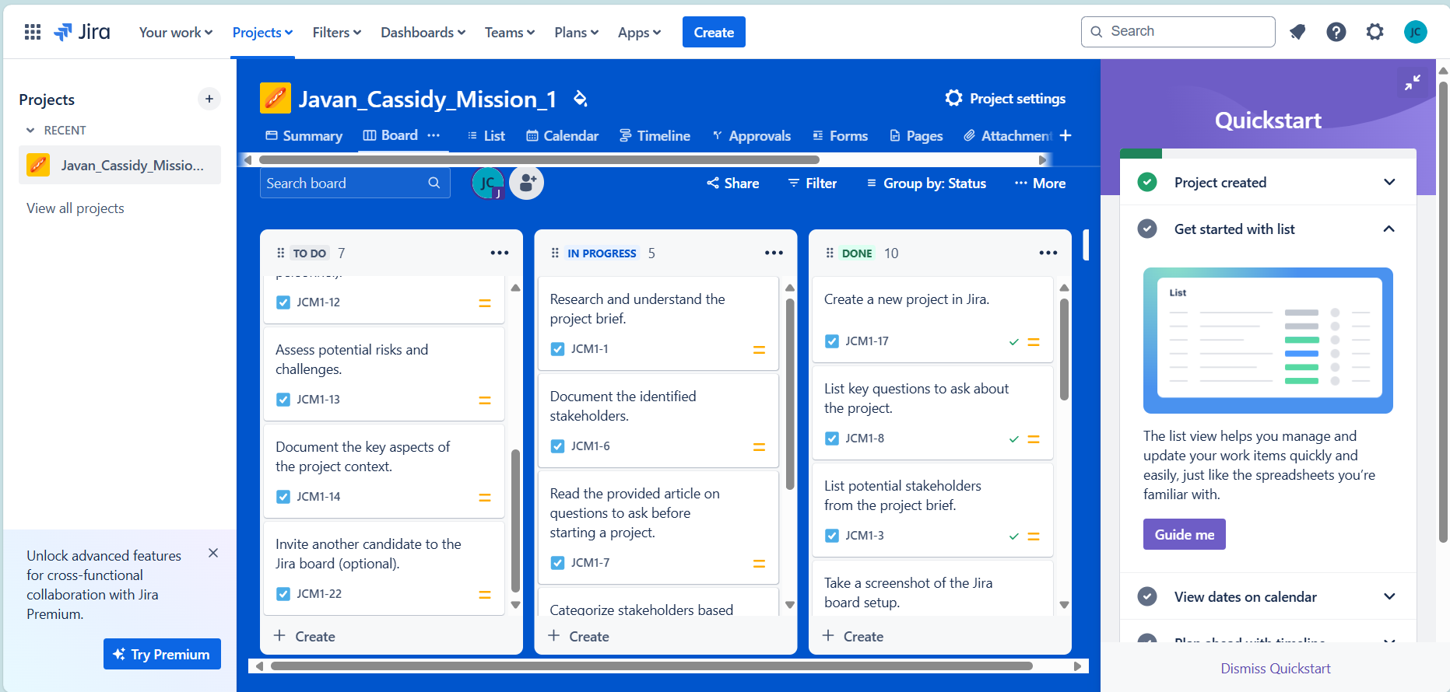
Familiarise with tools for Task Management
Introduction: Task management tools like Jira are super helpful for staying on top of tasks and projects. They give you a structured way to organize, prioritize, and track progress, so nothing slips through the cracks. Jira has awesome features for working with your team, streamlining workflows, and making sure everything gets done on time and done well. It's a great way to boost productivity and manage your time effectively.
Javan Cassidy
Advanced Full Stack Developer

Slide 7

Vehicle Recognition Application Demonstration
Using React.jsx and Microsoft Azure
Javan Cassidy
Advanced Full Stack Developer
Notes:
"This application allows users to upload images of vehicles and receive instant recognition results, identifying the vehicle’s type, brand, and model."

Slide 8
Key Features
Image Upload Interface
API Integration with Azure Cognitive Services
Result Display
Error Handling
Responsive Design
Javan Cassidy
Advanced Full Stack Developer
Notes:
"This application allows users to upload images of vehicles and receive instant recognition results, identifying the vehicle’s type, brand, and model."

Slide 9
Image Upload Interface
Javan Cassidy
Advanced Full Stack Developer
Notes:
Description of How Users Select and Upload an Image
Selecting an Image:
User Interface:
Users see a form labeled "Upload Your Vehicle Image."
There is a file input element for selecting an image file from the user’s device.
Selecting the Image:
Users click the "Choose File" button.
A file dialog opens, allowing users to navigate through their device’s file system.
Users select the desired image file and confirm their selection.
Image Preview:
Upon selecting the image, a preview appears below the form.
This allows users to verify the selected file before submitting.
Uploading the Image:
Submitting the Form:
After selecting the image, users click the "Upload" button.
This triggers the form submission, sending the image file to the server.
API Call:
The selected image file is encapsulated in a FormData object.
An API request is made to Azure Cognitive Services using axios.
The image is sent along with necessary headers for authentication.
Receiving Results:
Azure Cognitive Services processes the image and returns a JSON response with analysis results.
The results, including vehicle type, brand, model, and colors, are displayed on the page.
Handling Errors:
If an error occurs during the process, an error message is displayed, informing the user of the issue.

Slide 10

Vehicle Recognition Application Demonstration
Using React.jsx and Microsoft Azure
Javan Cassidy
Advanced Full Stack Developer

